Slide 1
INTRODUCTION TO C
Presented By S.R.Zameer

Slide 2


Slide 3
What is C?
C is a computer programming language developed in 1972 by Dennis M. Ritchie at the Bell Telephone Laboratories to develop the UNIX Operating System. C is a simple and structure oriented programming language.

Slide 4
What is C?
C is also called mother Language of all programming Language. It is the most widely use computer programming language, This language is used for develop system software and Operating System.

Slide 5
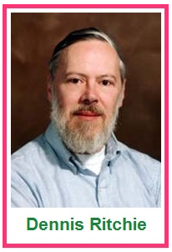
Who is he?

Slide 6
Where we use C Language?
C Language is mainly used for;
Design Operating system
Design Language Compiler
Design Database
Language Interpreters
Utilities
Network Drivers
Assemblers

